Slide 1
The Battle of the Neighborhoods
Coursera Capstone
Brian Feldman

Slide 2
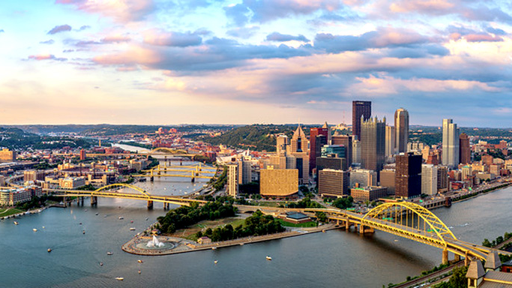
Overview
Pittsburgh has grown and reinvented itself significantly over the past 30 years. Through this development, each neighborhood’s offerings has changed. The findings from this analysis can be beneficial to the following groups.
Residents moving from out of town
City residents evaluating suburbs
Residents and visitors looking to review neighborhoods

Slide 3
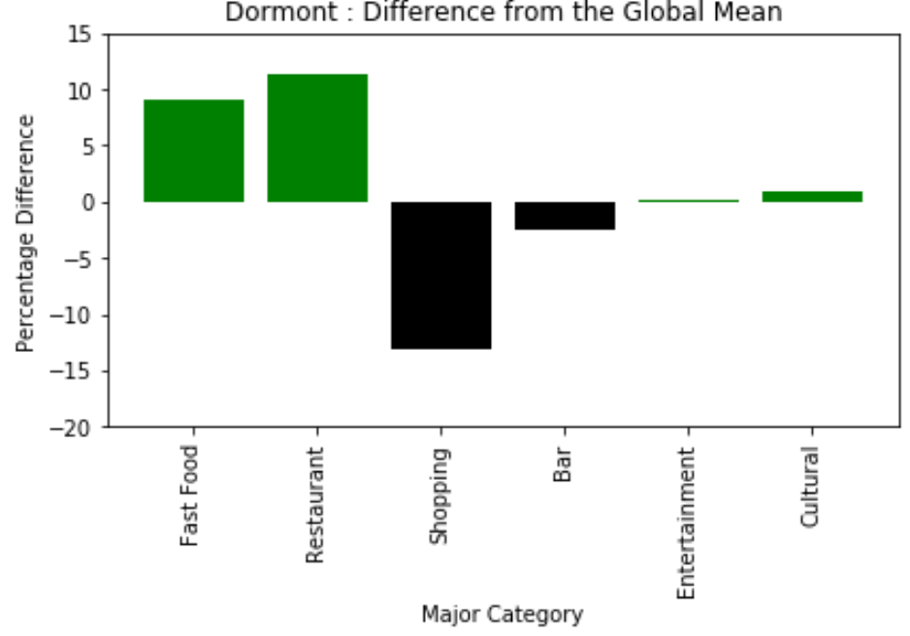
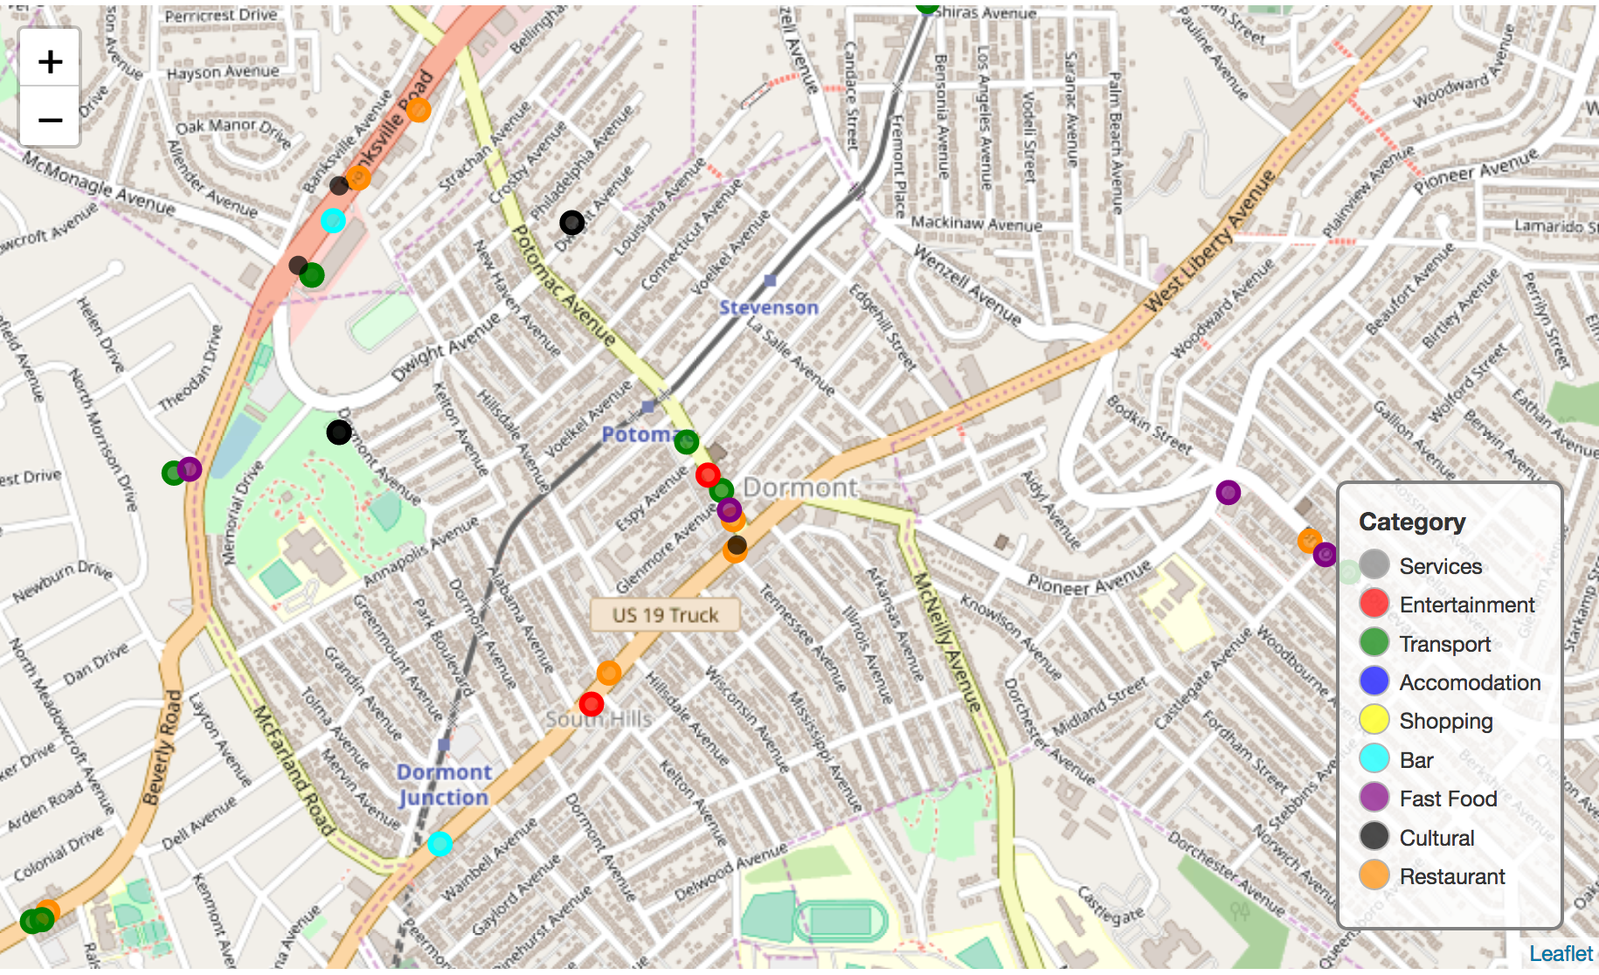
dormont
Dormont has about 10% the global average with both fast food and restaurants. People interested in having a greater food selection would enjoy this neighborhood.
Due to the higher incidence of fast food, some of the restaurants may be focused more on the lower end of the price spectrum.
Shopping is about 15% lower than the global mean so this neighborhood would not be ideal for people who enjoy shopping.

Slide 4
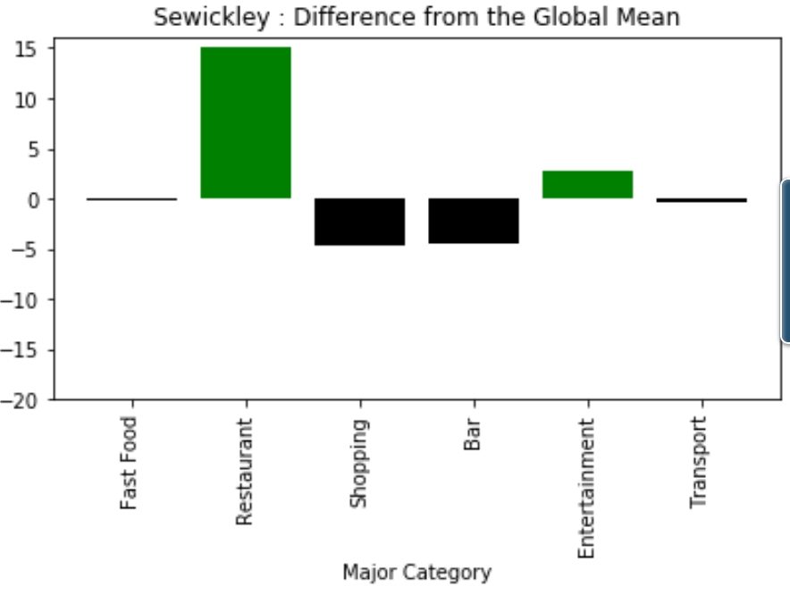
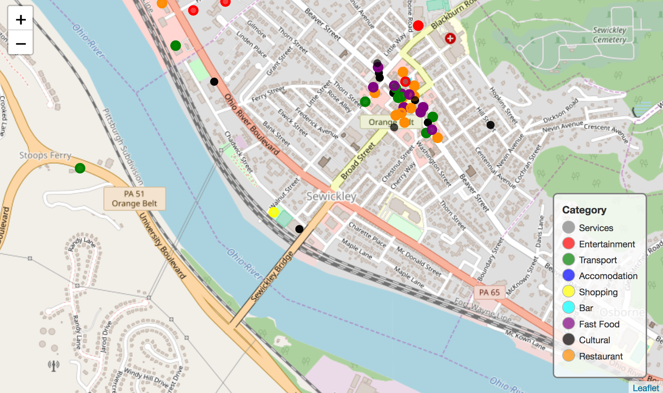
Swickley
Swickley has a 15% higher presence of restaurants than the global average while falling within 5% of the average for each of the other categtories.
Since most of the businesses in this neighborhood seem to be centered around a main area, there is likely a vibrant downtown area with more high end stores and restaurants.

Slide 5
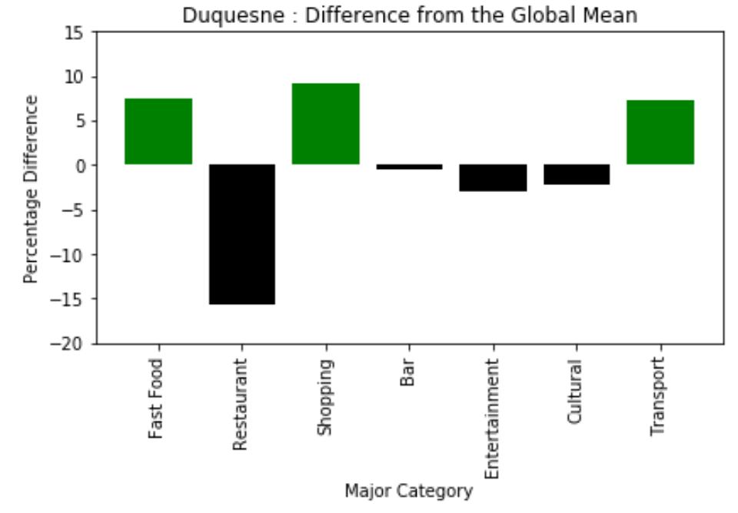
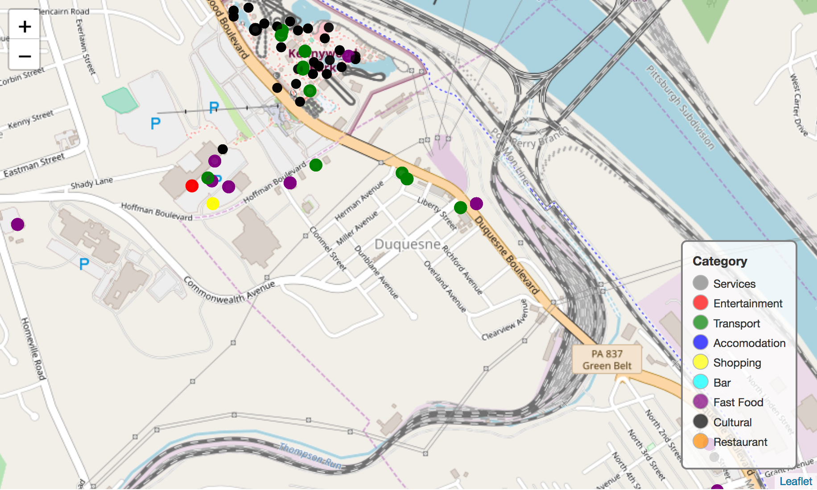
Duquesne
Duquesne is above the global mean in fast food (6%), shopping (10%), and transport (7%). This makes it appear as if the neighborhood is a downtown hub for a lower end neighborhood, but upon inspection of the map it is near an amusement park.
Many of the food stands at the amusement park are considered fast food and therefore skew the results of this neighborhood.

Slide 6
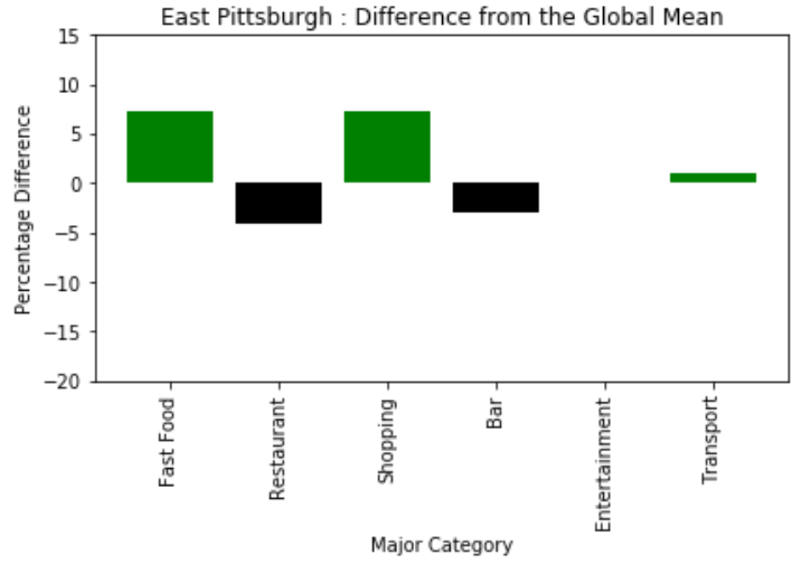
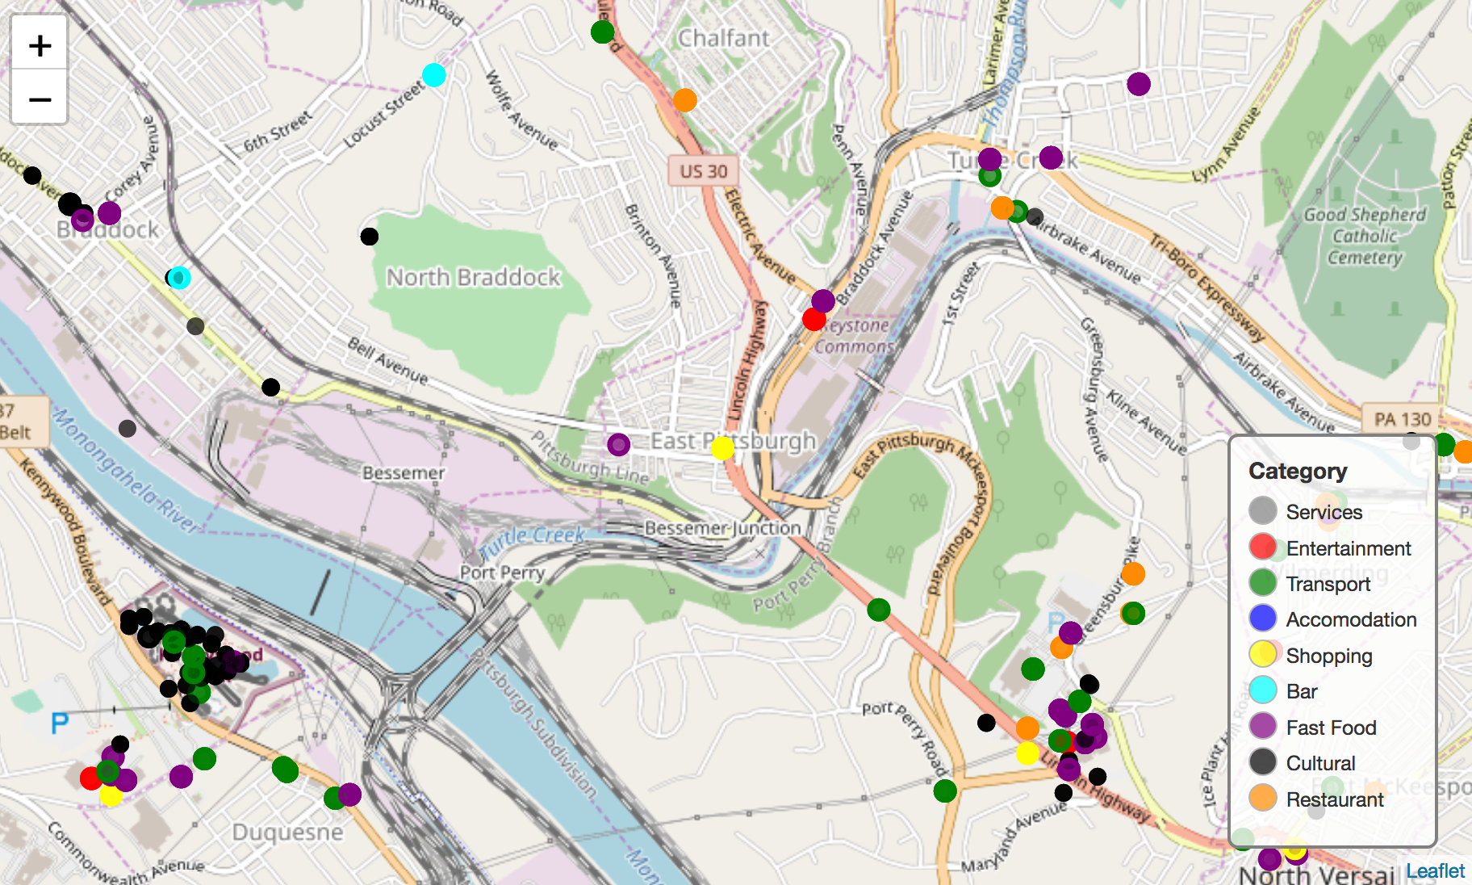
East Pittsburgh
East Pittsburgh is above the global mean in fast food (7%), shopping (5%), and entertainment (3%). This shows the neighborhood is likely close to a cultural hub of the city.
Based on the map, it is close to many other neighborhoods with other venues that may influence its cluster types.

Slide 7
Conclusion
Pittsburgh’s variety of venues offers a berth of neighborhoods where anyone can find something they enjoy.
Furthermore, these neighborhoods can use this analysis to identify what types of businesses they zone in the future.

